Slide 1

Tensor Train (TT) Decomposition and Applications
Salman Ahmadi-Asl
February 22, 2022

Slide 2
Outline
Different aspects of big data
Cure of dimensionality and tensor networks
Tensor Train (TT) decomposition and algorithms
Some application of TT format

Slide 3

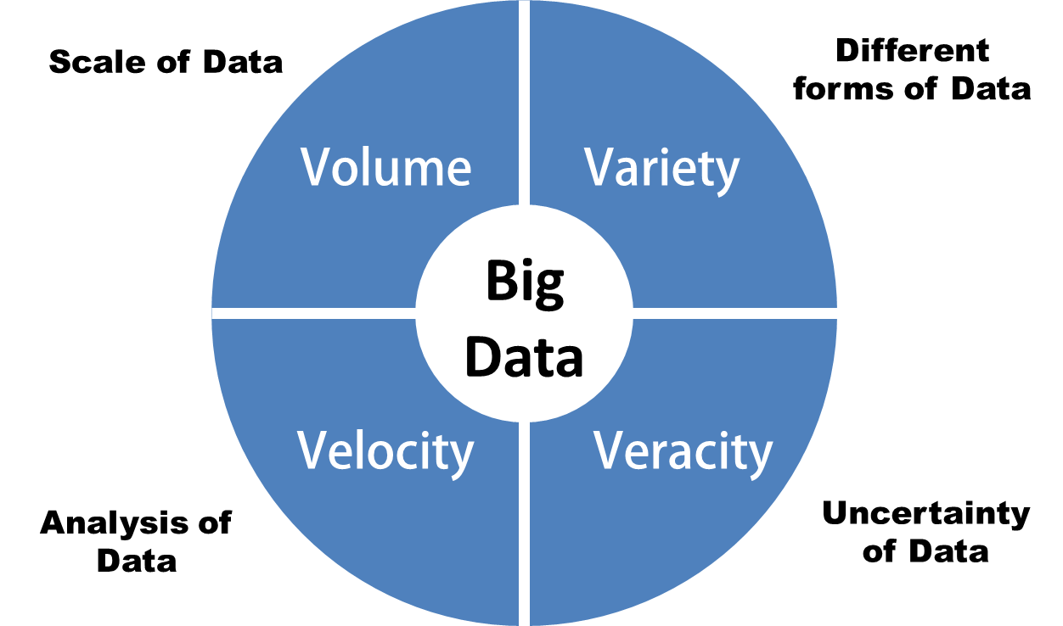
Different aspects of big data

Slide 4
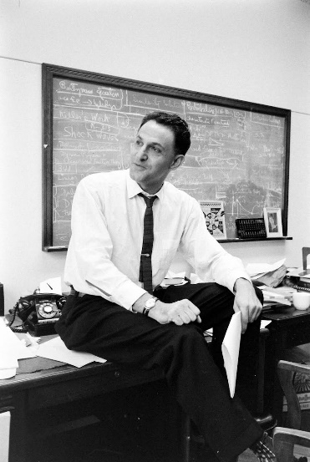
Challenge of handing high order tensors
Curse of
dimensionality
Richard Bellman

Slide 5
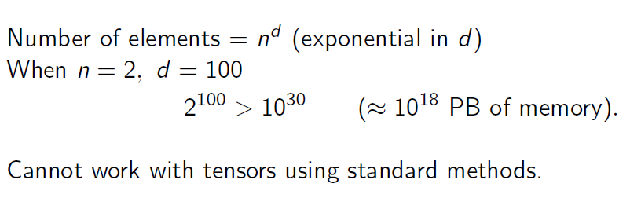
Higher order tensors
!
!
Cure of dimensionality prevents working on higher order tensors even for very small dimension.
It is necessary to work with compressed form (low-rank) of high order tensors.

Slide 6
How about Tucker and CPD for breaking the curse of dimensionality
Although Tucker decomposition can compress a data tensor but still the number of components of the core tensor is exponentially increased.
Although CPD scales linearly with the tensor order but it suffers from stability issues due to so called
degeneracy problem.
What can we do?

Slide 7

Tensor networks (TNs) are very promising data processing tools. They can be potentially used to extract useful information and knowledge from the underlying multidimensional data
What are Tensor networks?

Slide 8
Tensor networks (TNs)
Tensor decompositions (TDs) decompose principally data tensors into factor matrices, while tensor networks (TNs) decompose higher-order tensors into sparsely interconnected small-scale low-order core tensors.
Raw data
Decomposed Data
Lower order tensors

Slide 9
Tensor networks (TNs)
The Matrix Product State (MPS) or (vector) Tensor Train (TT), the Matrix Product Operator (MPO) or Matrix TT, the Projected Entangled-Pair States (PEPS) or Tensor Product State (TPS) and the Projected Entangled-Pair Operators (PEPO).

Slide 10
Tensor networks (TNs)
Honey-Comb lattice for a 16th order data tensor
Hierarchical Tucker (HT) or Tree Tensor Network State (TTNS)
with 3rd order and 4th order cores

Slide 11
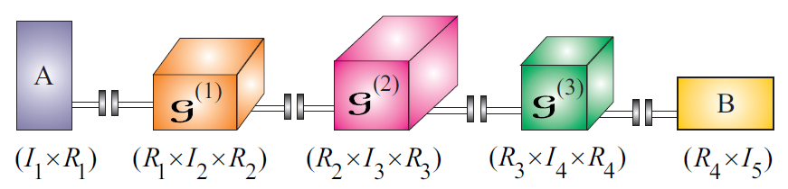
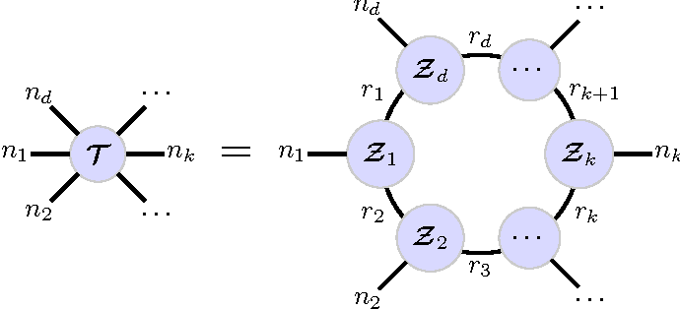

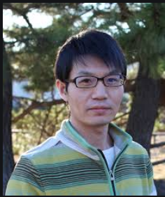

Revolution in scientific computing for handing higher order tensors
Tensor Train Decomposition
Tensor chain Decomposition
Ivan Oseledets
Mike Espig
Qibin Zhao

Slide 12
Tensor Train (TT) decomposition

Slide 13
Inspiration behind the TT concept
Wagons=TT cores
Wheels=Indices

Slide 14
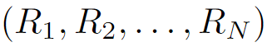
TT rank vs Tucker rank
Tucker rank is the rank of unfolding matrices mode-n unfolding
Tucker ranks
matrices of size
TT ranks is the rank of n-unfolding matrices of size
TT-ranks

Slide 15
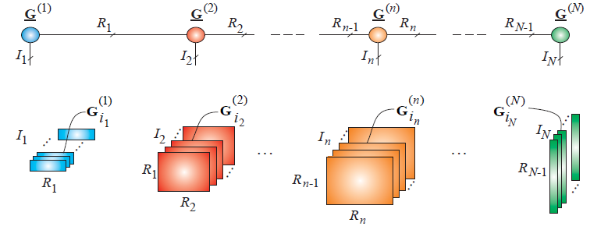
Slice-wise representation of the TT decomposition

Slide 16
Tensor Train (TT) decomposition of 3rd-order tensors
We are already familiar with TT decomposition of 3rd-order tensors which is the Tucker-2 decomposition.

Slide 17
Algorithms for Tensor Train (TT) decomposition
TT-SVD algorithm
ALS-Type algorithm
Gradient-based algorithms

Slide 18
TT-SVD for a 5rd-order tensor
TT decomposition can be computed in a fixed-rank or a fixed-precision way.
Fixed-rank algorithm
For a given fixed TT-ranks, the algorithms find a TT decomposition with the predefined TT-ranks.
Fixed-precision algorithm
For a given fixed precision, the algorithms automatically find the TT-ranks so that the predefined precision
is satisfied.

Slide 19
TT-SVD algorithm
TT-SVD is a basic algorithm for decomposing a tensor in TT format. It involves computation of the SVD of unfolding
matrices.

Slide 20
TT-SVD for a 5rd-order tensor

Slide 21
TT decomposition of a 5rd-order tensor using sequential Tucker-2 decomposition

Slide 22
TT-cross algorithm
Do we really need SVD? How the computational complexity of the TT-SVD can be
reduced?
It turns out that we do not need SVD and just a low-rank approximation is sufficient
at each iteration of the TT-SVD.
Randomization
Two efficient frameworks
Skeleton (cross approximation) or CUR decomposition

Slide 23
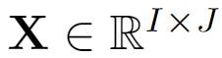
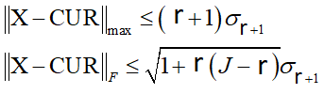
Skeleton (cross approximation) or CUR decomposition
TT-cross approximation is a variant of the TT-SVD in which at each iteration cross approximation
is used to generate the TT core tensors.

Slide 24
Number of parameters for different kinds of tensor networks and tensor decompositions

Slide 25
ALS-type algorithm for the TT decomposition
Similar to the CPD and the Tucker decomposition, the ALS algorithms can be developed for the TT decomposition.
More precisely, all TT cores are kept fixed except one and that is updated

Slide 26
ALS-type algorithm for the TT decomposition

Slide 27
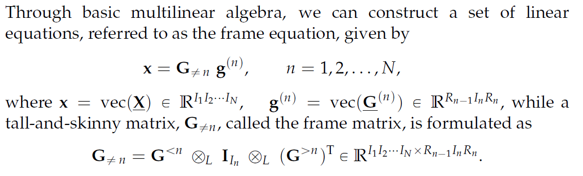
ALS-type algorithm for the TT decomposition

Slide 28
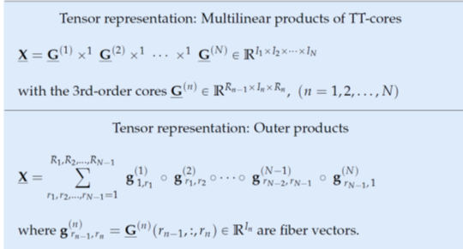
Different representation of the TT decomposition

Slide 29
Linear algebra operations in TT format

Slide 30
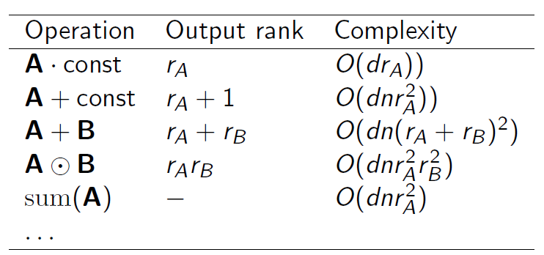
Linear algebra operations in TT format
Matrix-Matrix multiplication
Hadamard product
Super fast Fourier transform
Inner product
Computation of the Frobenius norm

Slide 31
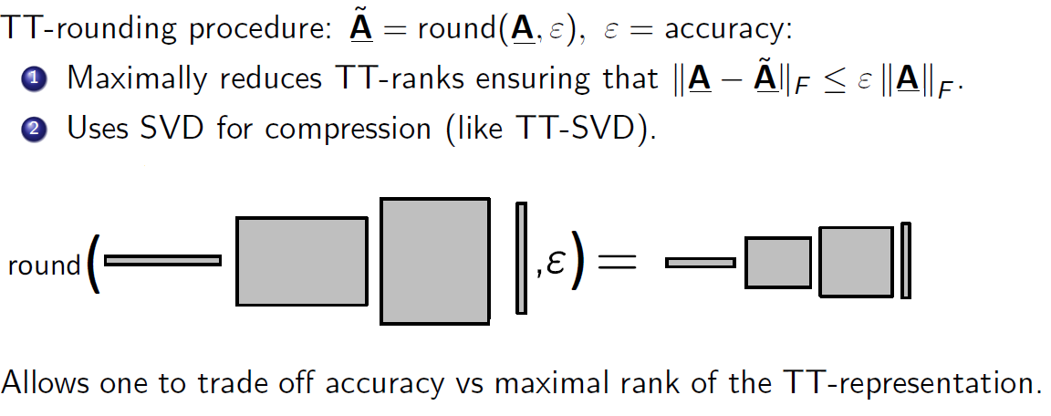
TT rounding

Slide 32
TT rounding algorithm
The TT cores obtained by the TT-SVD may have large TT-ranks and we need to recompress the data tensor again.
Here the TT-rounding algorithm is used to reduce the TT-ranks and recompress the data tensor.
The advantage of this algorithm is that it just deals with unfolding of TT cores which are quite small matrices compared to the original n-unfolding matrices.

Slide 33
Related TT decomposition
This is used for approximating matrices in the TT format.

Slide 34
Tensor Train (TT) decomposition and CPD

Slide 35
Tensor Train (TT) decomposition and CPD
CPD is a special TT decomposition with core tensors of particular structure (diagonal)

Slide 36
Linear algebra operations in TT format

Slide 37
Linear algebra operations in TT format

Slide 38
Quatization
A representation of a matrix/vector (after the tensorization) in the TT format is called Quantized Tensor Train (QTT) decomposition
The quantization can be also introduced as a the procedure of reshaping a vector/matrix to a tensor in which the size of the modes is small, e.g. 2, 3, 4. More precisely, a large vector or matrix is reshaped (or tensorized) to a higher order tensor after which it is compressed into the TT format.

Slide 39
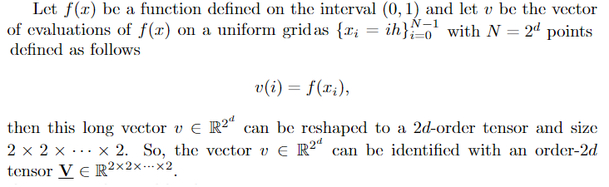
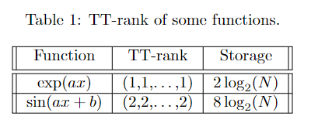
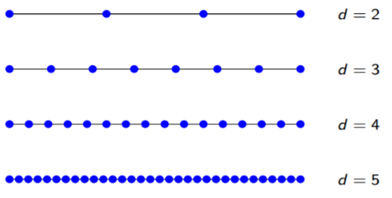
Quatization

Slide 40
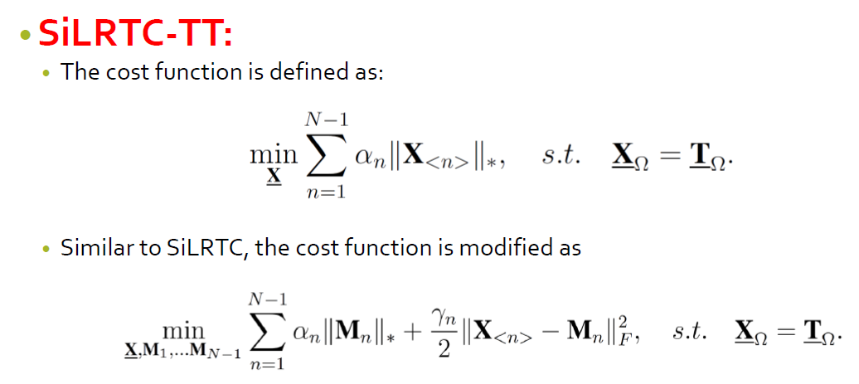
Tensor completion based on TT format

Slide 41
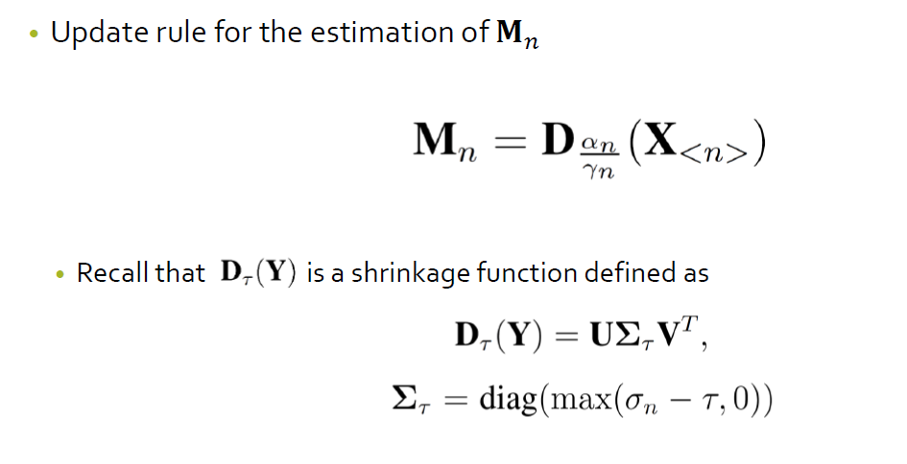
Tensor completion based on TT format

Slide 42
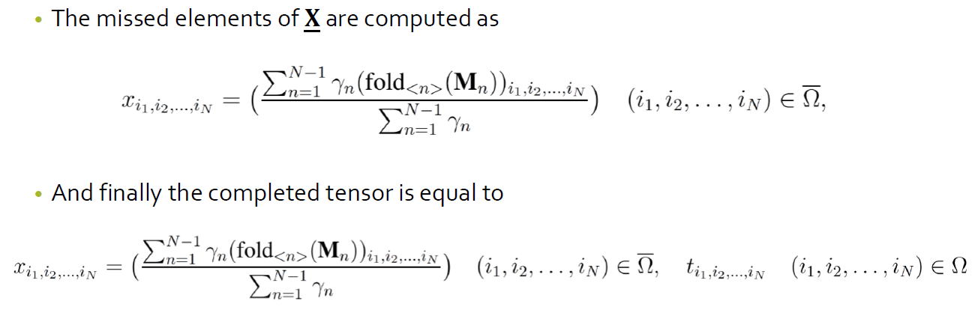
Tensor completion based on TT format

Slide 43
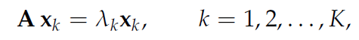
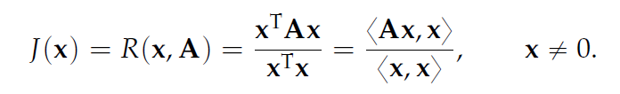
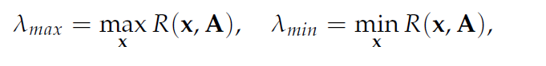
Computing a Few Extremal Eigenvalues and Eigenvectors

Slide 44
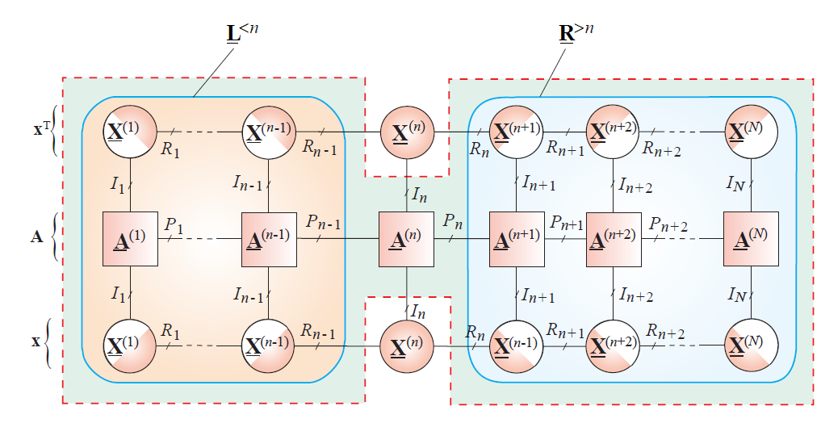
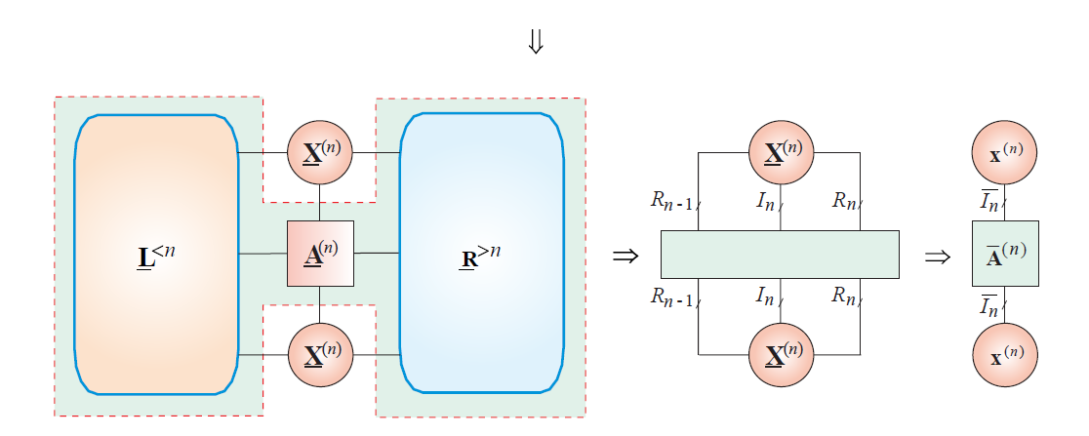
Computing a Few Extremal Eigenvalues and Eigenvectors

Slide 45
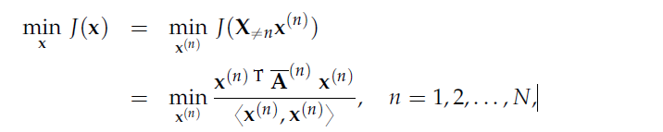
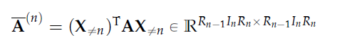
Computing a Few Extremal Eigenvalues and Eigenvectors

Slide 46
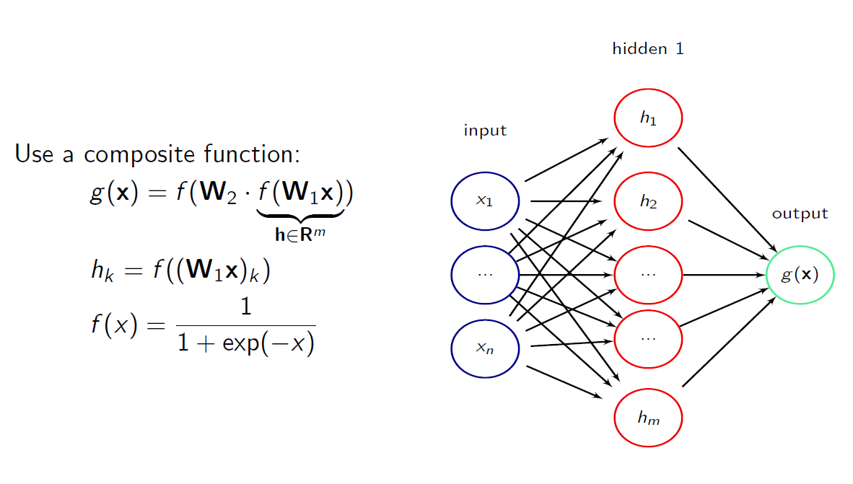
Neural Network Compression

Slide 47
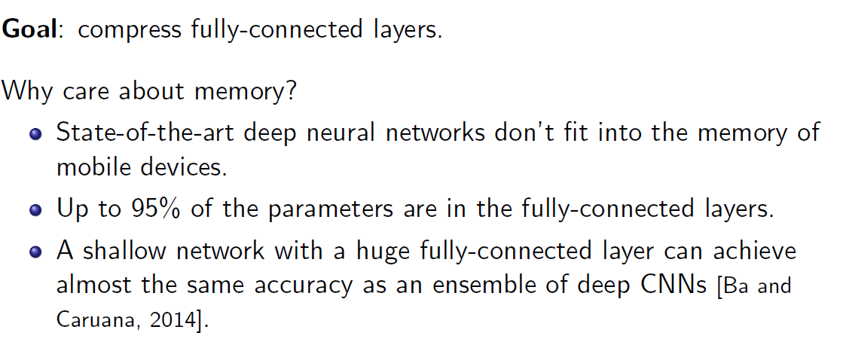
Neural Network Compression

Slide 48
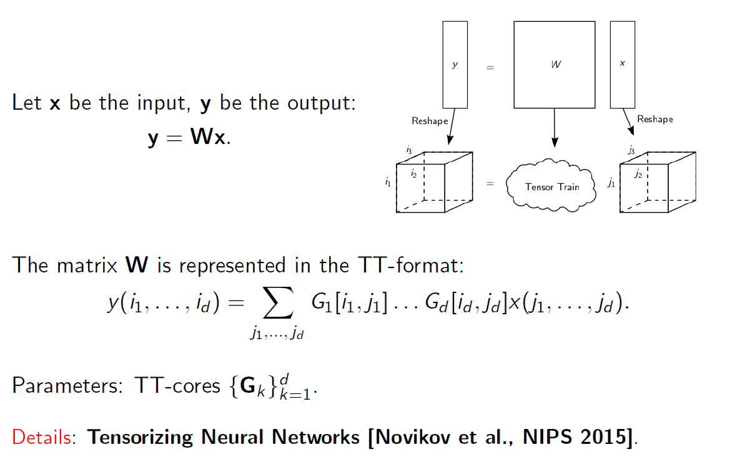
Neural Network Compression

Slide 49
Summary
TT-decomposition and corresponding algorithms are a good way to work with huge tensors.
Memory and complexity depend on d linearly ) no curse of dimensionality.
TT-format is efficient only if the TT-ranks are small. This is the case in many applications.

Slide 50
Thanks for your attentions
Any question?

